Slide 1

Traces

Slide 2
Progress
Mostly functional backend
Connected skeleton app to backend
Google Maps with a location marker setup so far.
Kicking butt, taking names

Slide 3
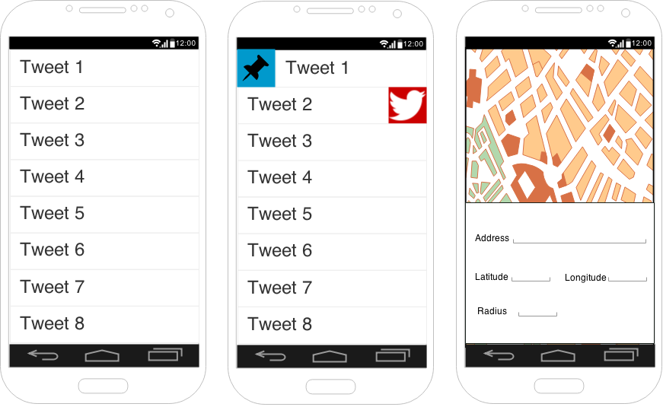
Mockups

Slide 4
Tasks
Mo - Advanced backend “glue”
Vikas - Placement of pins on map
Tyrone - List view of tweets
Andrew - Pin/Twitter swipe actions (list view)
Phillip - Search menu

